Slide 1


Industry Work Presentation
By
Institute of Computer Technology, Ganpat University
Date: 12 May 2024
Patel Vismay Sandipbhai (20162101015)

Slide 2
Week-1
Training on JavaScript.
Learning about basic JavaScript functions.

Slide 3
Week-2
Training on jQuery.
Learning about basic jQuery functions, jQuery effects, jQuery traversing and Ajax.
Exploring additional tools like slick slider carousels, flatpickr datetime picker, model, and owl-carousel.

Slide 4
Week-3
Training on React.js
Task: Building a todo app

Slide 5
Week-4
Continuing training on React.js
Tasks:
Creating a registration form
Storing data on local storage
Rendering data from local storage into a table
Implementing add, edit, and delete options for the table
Rendering data from an external file and storing it into a table and utilizing a model to display data

Slide 6
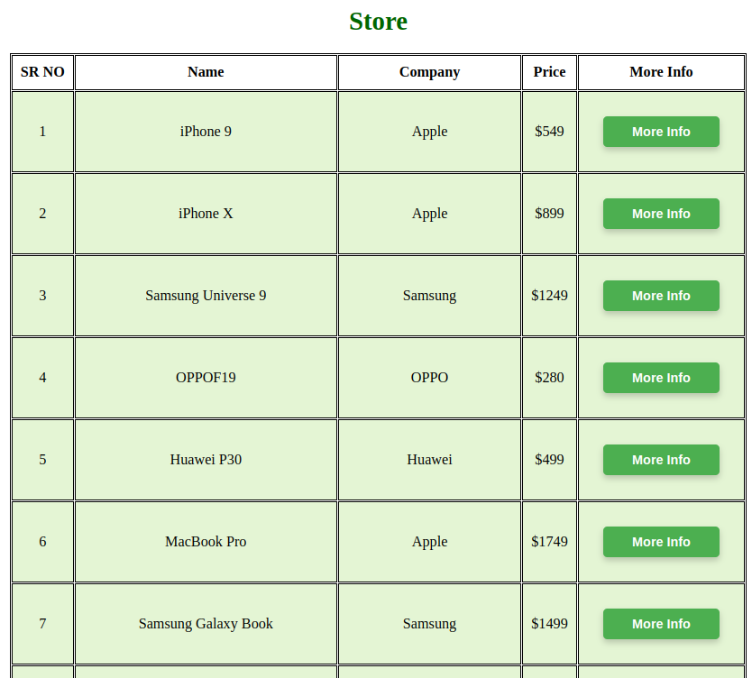
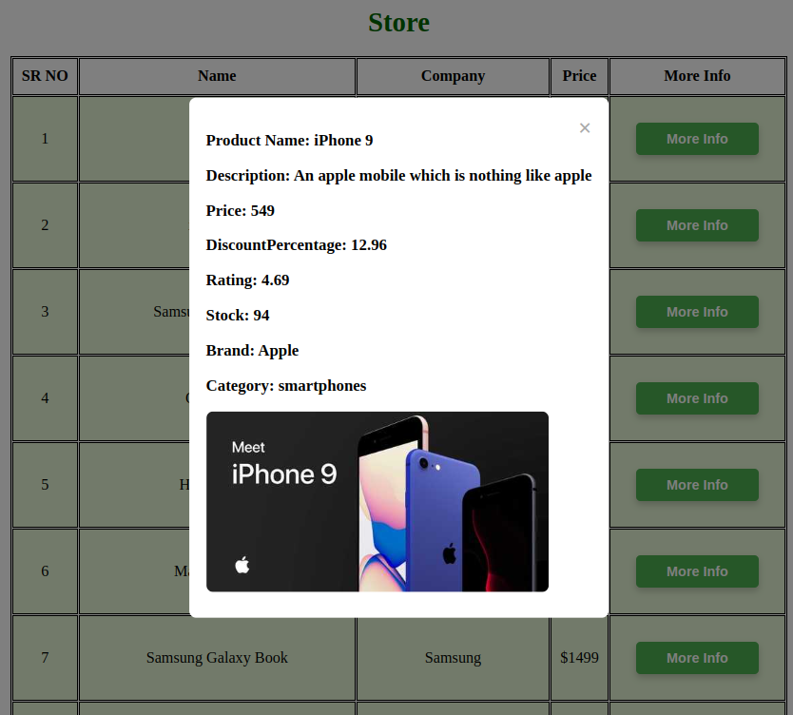

Slide 7
Week-5
Learning about JavaScript validation and validation plugins
Tasks:
Creating a registration form with all necessary validations

Slide 8
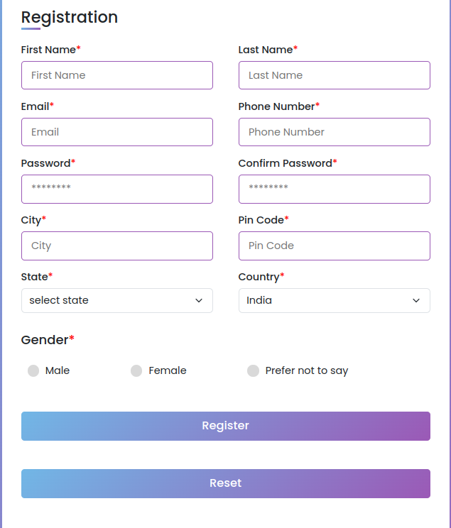
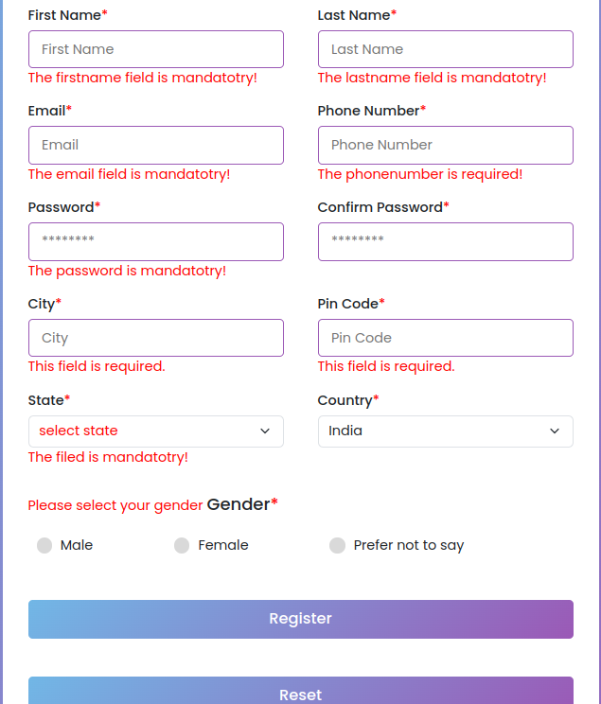

Slide 9
Week-6
Weather App Implementation:
Built weather apps with jQuery and React.js using OpenWeather API.
Interactive Counter Creation:
Developed counters with user input and functionalities like start, pause, reset.
Utilized create-react-app:
Leveraged features for project setup, optimization, and advanced usage.
Enhanced React.js Proficiency:
Strengthened understanding and practical skills for dynamic web app development.

Slide 10
Week-7
Appointment Booking Website:
Objective: Develop a user-friendly appointment booking website with seamless authentication and intuitive dashboard functionality.
Search Filter Component in React:
Objective: Create a reusable search filter component in React to enhance data exploration and facilitate efficient search operations across datasets.
Task Management Application:
Objective: Build a task management application with intuitive task organization, complete with filtering and sorting capabilities for enhanced productivity.

Slide 11
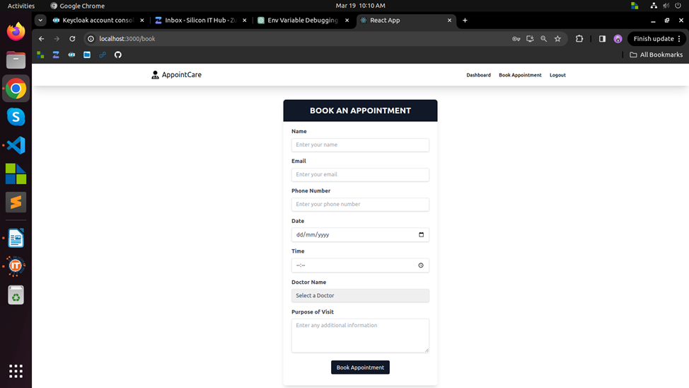

Slide 12
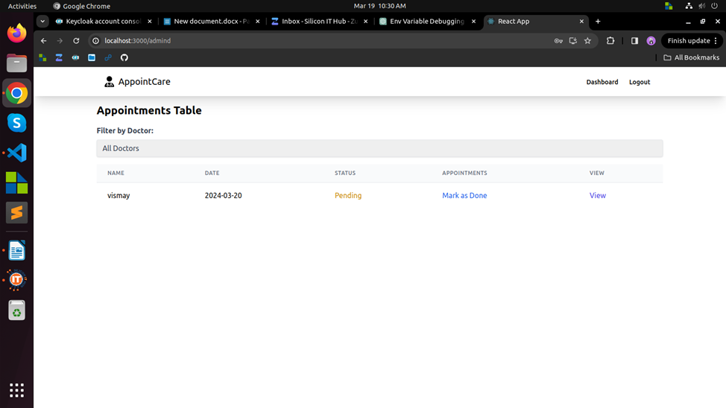

Slide 13
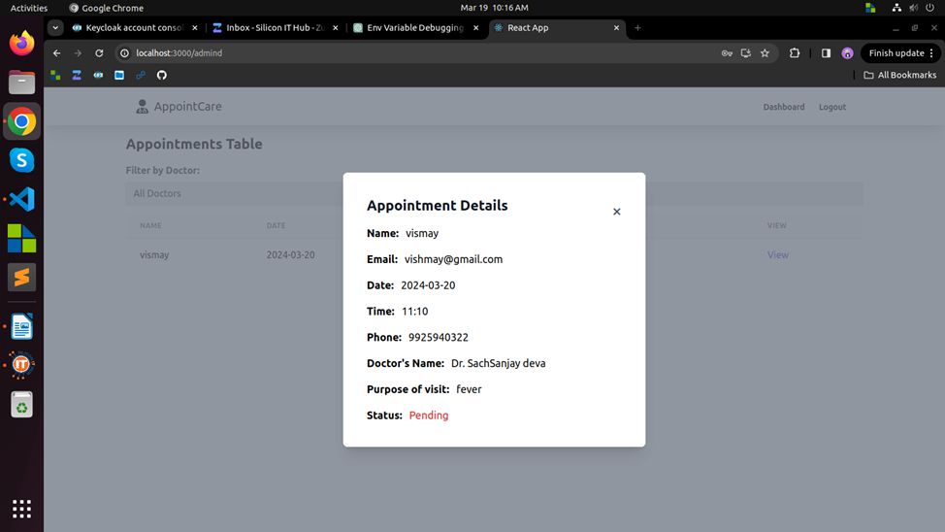

Slide 14
Week-8
Dynamic Job Role Management:
Effortlessly add or remove job roles to adapt to organizational needs.
Simplified Employee Registration:
Streamlined process for registering new employees, capturing essential information.
Insightful Dashboard:
Centralized dashboard offers a comprehensive view of all employees, facilitating informed decision-making.
Enhanced Organizational Control:
Manage job roles and employee records to optimize operations and ensure compliance.

Slide 15
Week-9
Efficient Data Handling
Proficiently managed significant data volumes, including 10,000 records.
Dynamic Filtering Implementation
Implemented robust filtering for efficient data retrieval
Interactive Table Display
Utilized interactive components for clear data visualization
Seamless Pagination Integration
Integrated pagination for improved performance and navigation

Slide 16
Week-10
Online Exercise Completion:
Sharpened problem-solving skills through interactive exercises completion.
Code Optimization Techniques:
Maximized application performance with meticulously optimized code.
React Code Splitting Mastery:
Elevated resource utilization in React applications through expert code splitting mastery.
Site Optimization:
Dramatically improved website performance through strategic techniques.

Slide 17
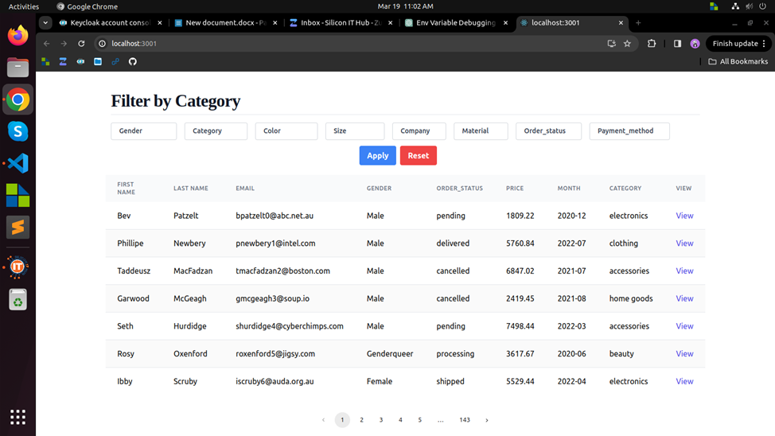

Slide 18
Week-11
Introduction to React Redux Core:
Explored core concepts of React Redux for efficient state management.
Development of Todo App:
Utilized React Redux for seamless state handling in a functional Todo app.
Creation of Dashboard:
Designed dynamic dashboard with React Redux for comprehensive data display.
Integration of Redux Middleware:
Improved app performance with Redux middleware for asynchronous actions.

Slide 19
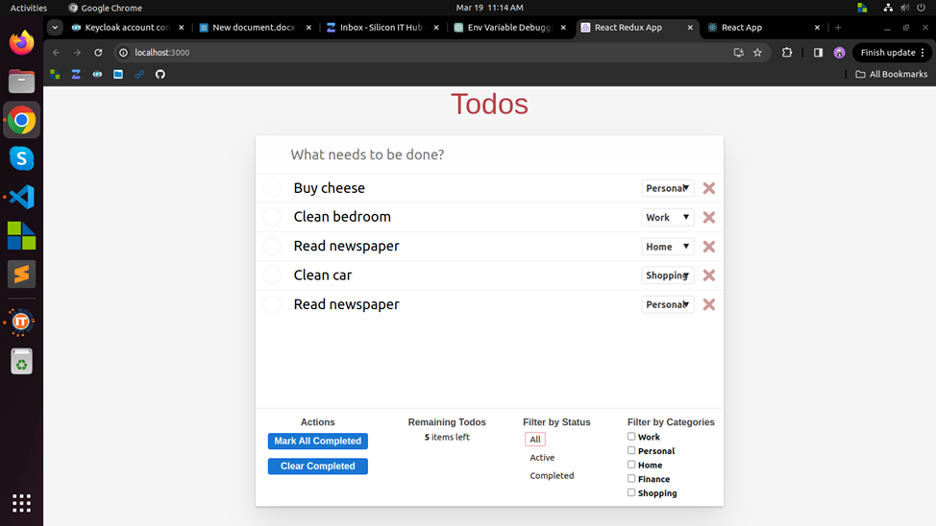

Slide 20
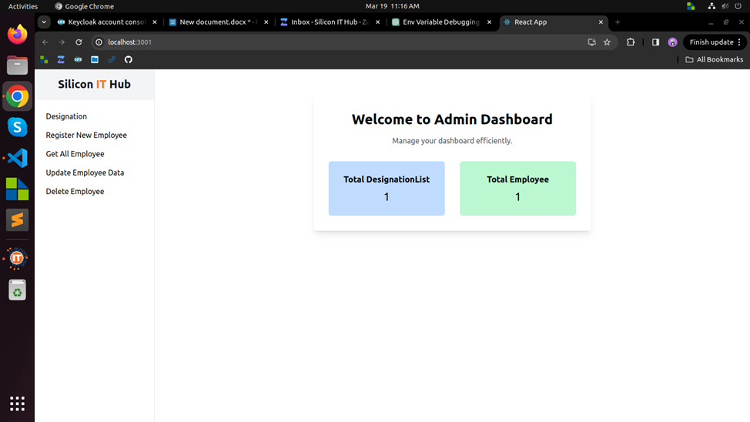

Slide 21
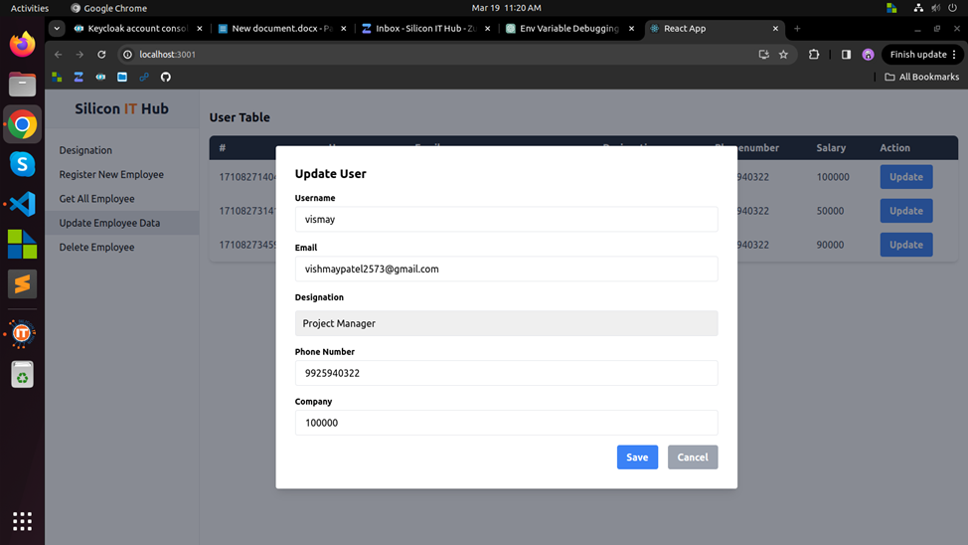

Slide 22
Week-12
Introduction to React Redux Toolkit:
Mastered streamlined state management with Redux Toolkit.
Social Media App Development:
Created engaging app with dynamic features.
Efficient State Handling:
Leveraged Redux Toolkit for seamless data flow.
Enhanced User Interaction:
Implemented posting, reactions, and notifications for active user participation.

Slide 23
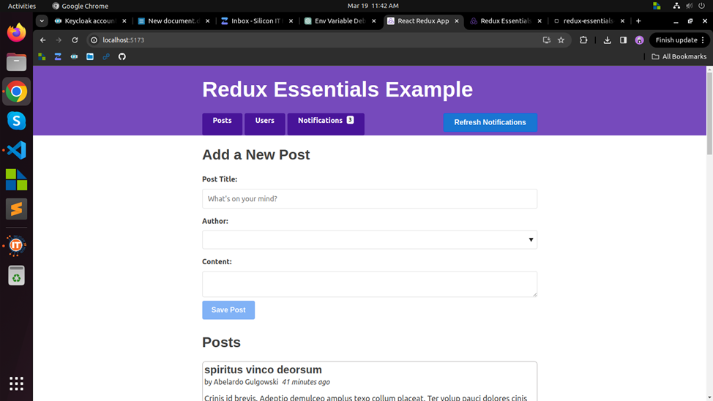

Slide 24
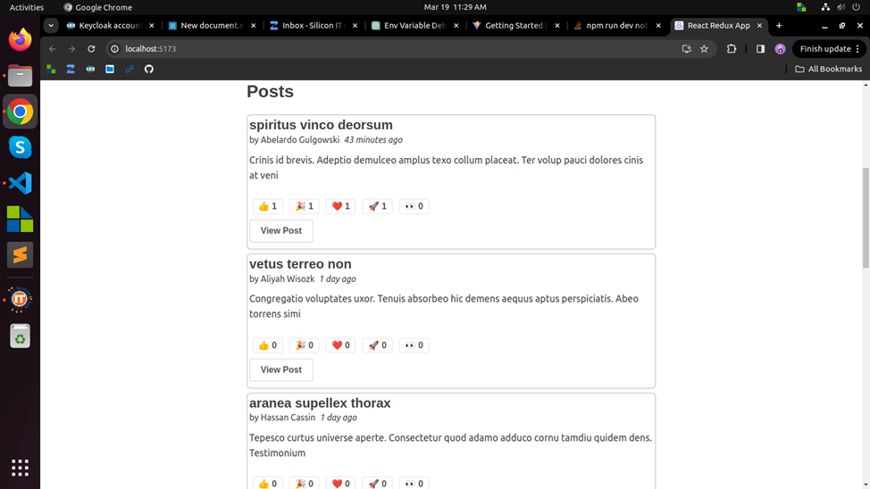

Slide 25
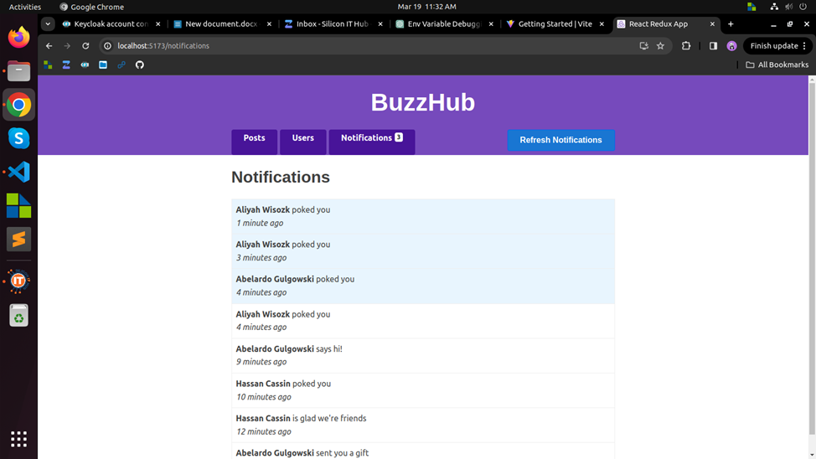

Slide 26
Week-13
Budget Buddy App:
Implemented essential financial tracking features: Enabled users to add cash in and cash out transactions, enhancing their ability to monitor expenses accurately.
Enhanced user control: Improved management of payment categories and methods, providing users with better organization and control over their financial data.
Professional Portfolio Website:
Developed a professional website highlighting skills, projects, and experience with sections like "About Me," "Projects," and "Blogs."
Ensured seamless navigation and a user-friendly interface for an engaging browsing experience, encouraging interaction with the content.

Slide 27
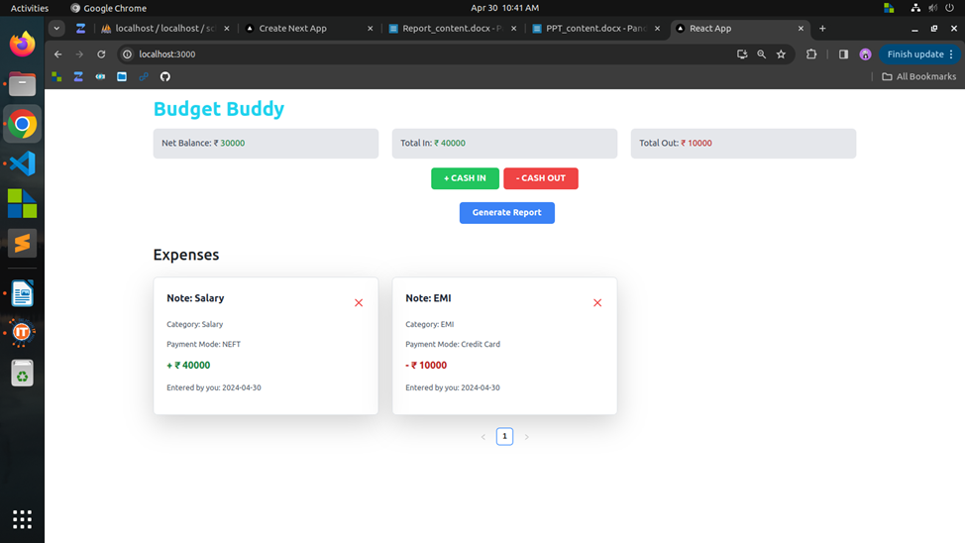

Slide 28
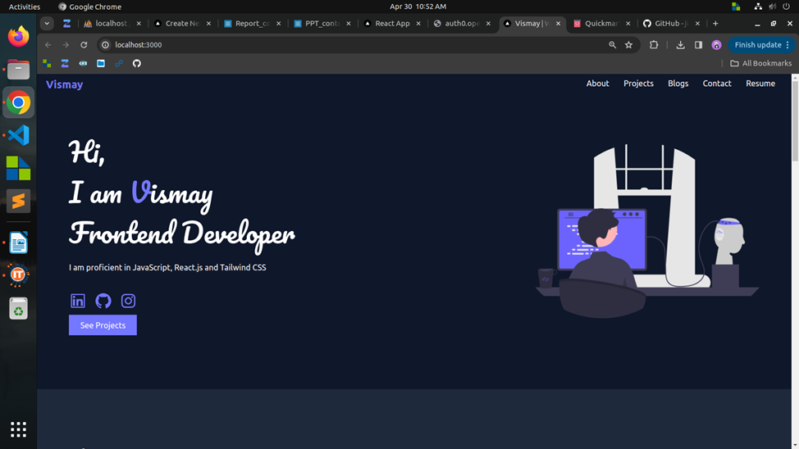

Slide 29
Week-14
CineSwap Development:
Introduced "CineSwap: Your Ultimate Movie & TV Show Exchange" with React and TMDB API, facilitating movie and TV show trading.
Incorporated browsing features, providing users with essential movie details for informed decision-making.
Learning Next.js:
Initiated Next.js learning journey, focusing on project setup and routing basics.
Explored Next.js features to grasp its advantages and applications in web development.

Slide 30
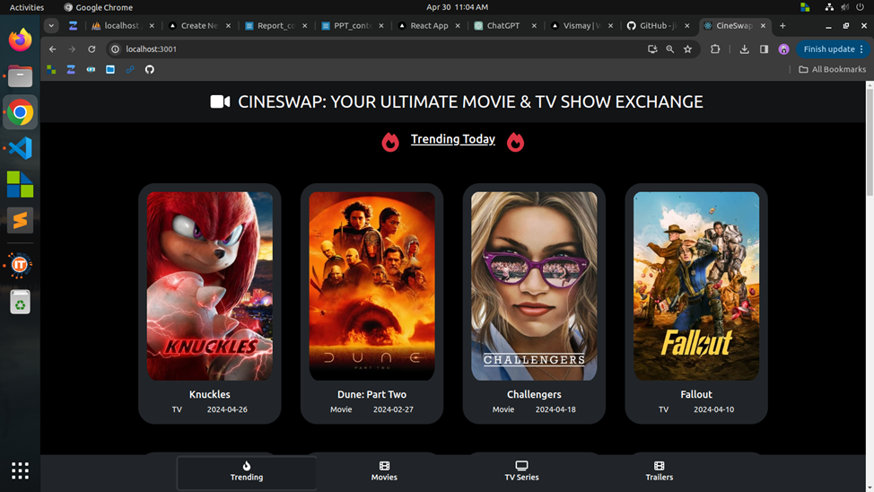

Slide 31
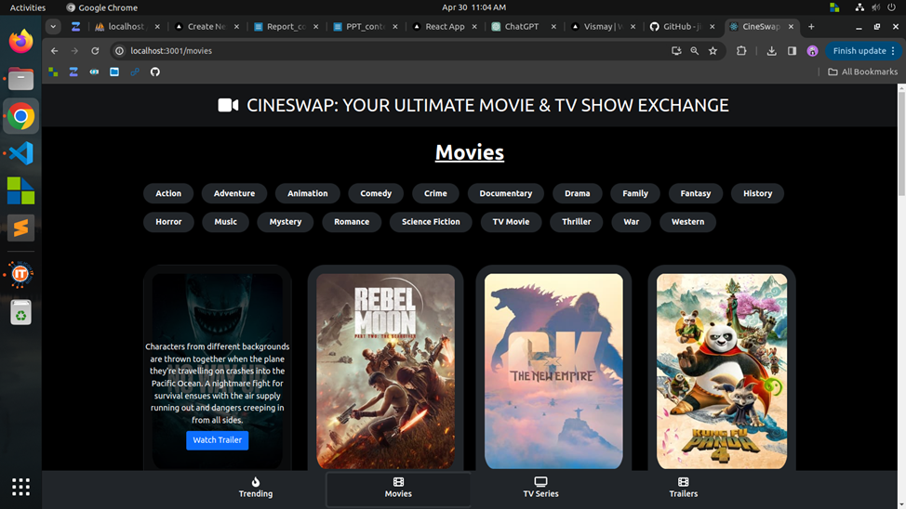

Slide 32
Week-15
Authentication Mastery:
Implemented secure user registration, login, and profile management using Appwrite, ensuring robust security measures for password recovery and verification processes through Nodemailer integration.
Authentication Mastery:
Successfully integrated MongoDB for secure data management, effectively managing user authentication data and profiles to enhance overall security.
Authentication Mastery:
Developed a comprehensive dashboard interface with nested layouts and pages using Next.js, implementing various styling techniques and optimizations to improve user experience and application performance.

Slide 33
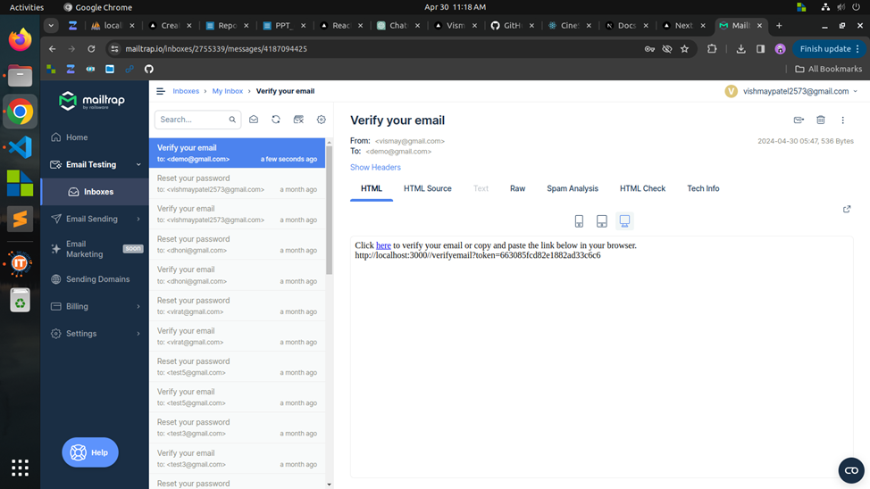

Slide 34
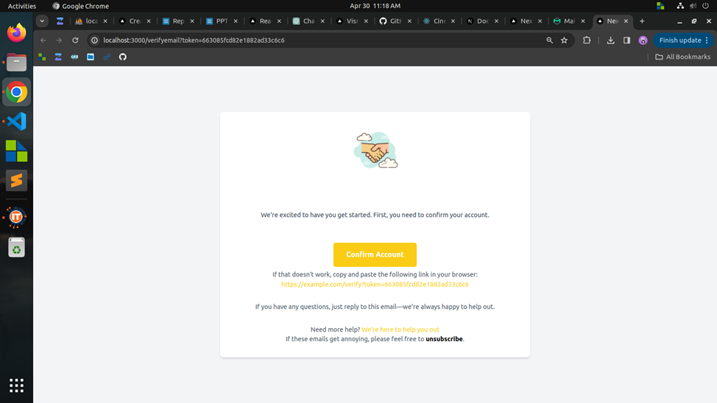

Slide 35
Week-16
Developed TechTonic blog site with Next.js and PHPMyAdmin, featuring user authentication and role-based dashboards.
Enabled dynamic blog creation, viewing, and interaction, including personalized user profiles and navigation bars.
Implemented user authentication with verification and various user roles for tailored experiences.
Configured navigation bar to adapt to user roles, offering relevant functionalities accordingly.

Slide 36
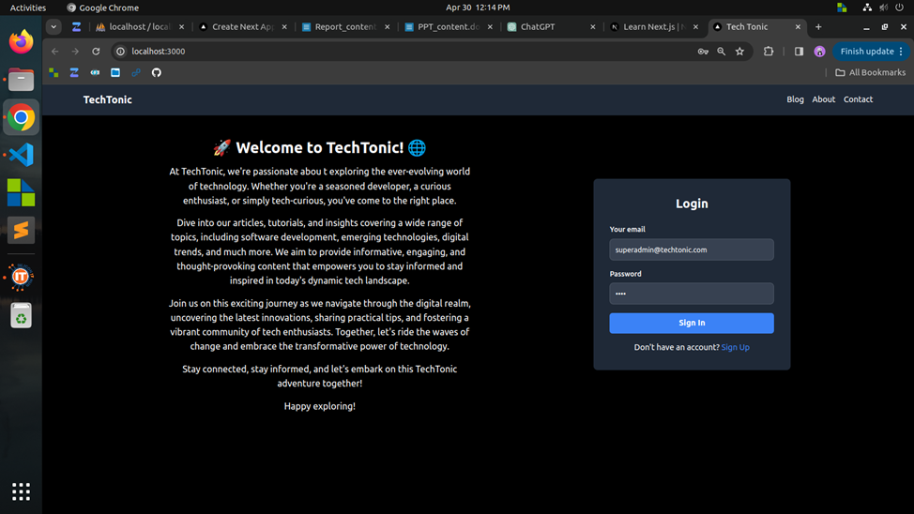

Slide 37
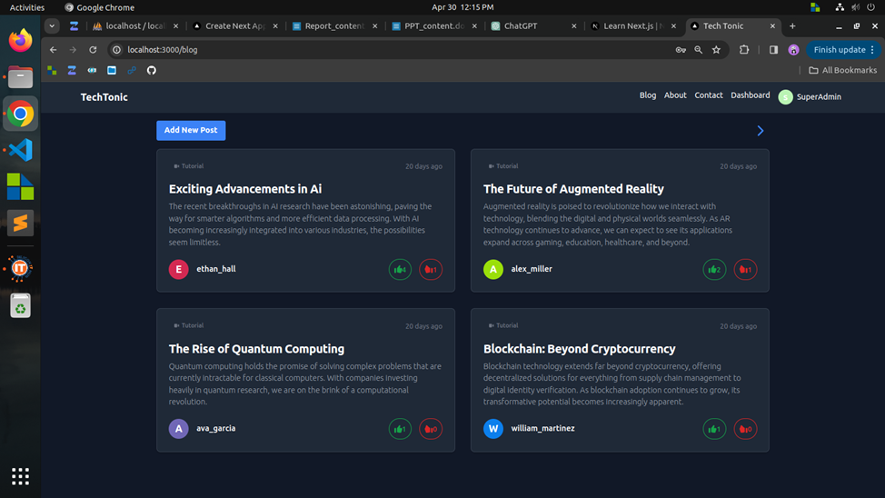

Slide 38
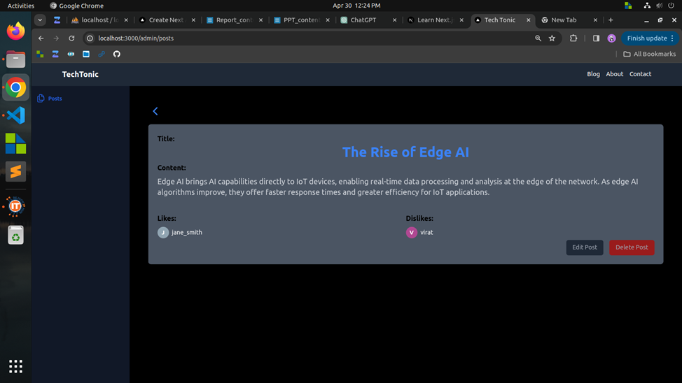

Slide 39
Week-17
Developed comprehensive school management system for efficient administration.
Modules include student and teacher management, bonafide certificate generation, library management, class and fees management, transportation management, and attendance tracking.
Implemented features for adding, updating, and managing student and teacher details, generating bonafide certificates, managing library inventory, tracking fees, managing transportation details, and tracking student attendance.

Slide 40
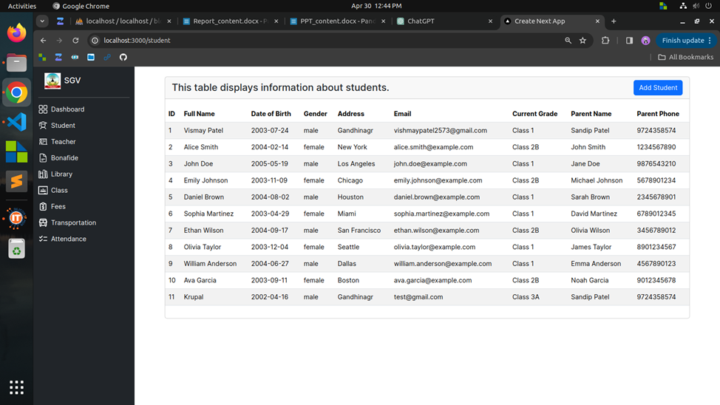

Slide 41
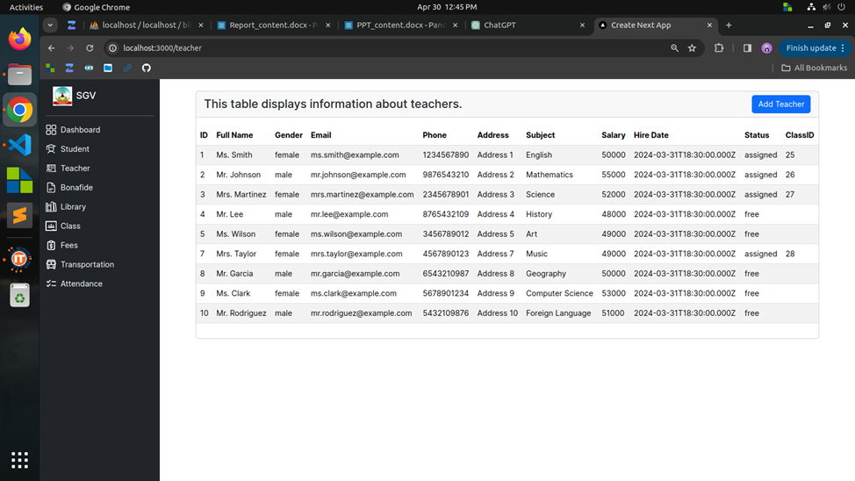

Slide 42
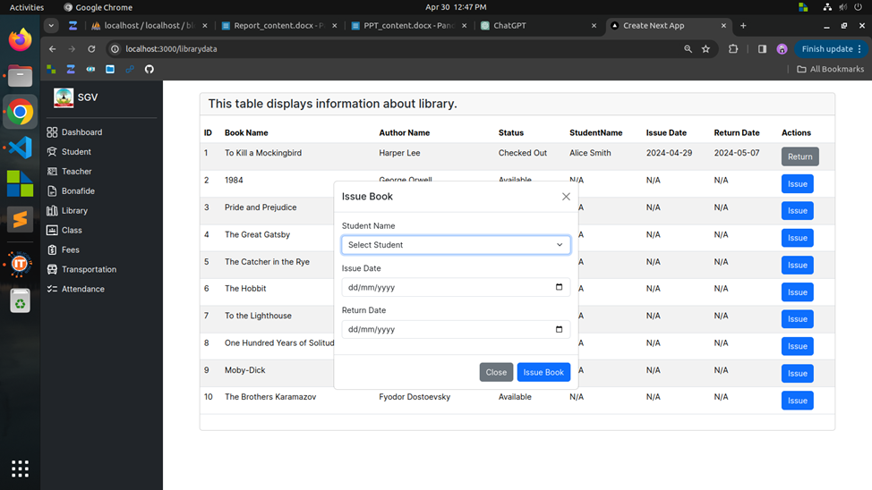

Slide 43
Thank You !!

